Slide 1
Project Title:
Expense Tracker Using
—
Presented By
Roll No.:55 - Pratik Eknath Ravan
Roll No.:57 - Snehal Sachin Vibhute
Roll No.:63 - Sarvesh Sagar Mahadik
Roll No.:69 - Swarup Samir Pal
Roll No.: 73 - Saniya Bharat Mane

Slide 2

Expense Tracker Using Java Swing
This presentation outlines the development of a Basic Expense Tracker built with Java Swing. The project offers a desktop-based solution for managing personal finance through intuitive graphical user interfaces. Our group members have collaborated to design, implement, and test this system, focusing on ease of use and functionality for users to track and control their monthly budgets efficiently.
The expense tracker application enables users to maintain comprehensive records of income and expenditures with detailed categorization. This tool aims to simplify financial management by analyzing spending patterns and providing clear summaries.

Slide 3
Introduction to the Expense Tracker
This project is a desktop-based Expense Tracker application built using Java Swing GUI components. It offers a rich, interactive interface where users can easily add, view, and modify their personal expense data.
Track and manage personal expenses
Interactive GUI with intuitive navigation
Monthly budget focus
Income versus expense comparison
Designed for monthly budget management, the tracker lets users monitor their income relative to expenses, enhancing financial awareness and control.

Slide 4




Project Objectives
Income Management
Expense Handling
Allow users to set their monthly income as a baseline for budgeting.
Enable adding and editing expenses including details like description, amount, date, and category for accurate tracking.
Transaction Viewing
Summary Dashboard
Present all transactions in a clear list format for transparency and easy review.
Display a concise overview of the user's financial status including income, total expenses, and remaining balance.

Slide 5
System Architecture Overview
GUI Layer (Swing)
Storage Layer
Provides the interactive user interface for data entry and visualization.
Uses in-memory data structures such as ArrayList<Expense> to store transaction data dynamically during runtime.
Logic Layer
Data Flow
Manages expense objects and calculations for income and balance.
User inputs captured via GUI
Processes user input and updates data accordingly.
Logic processes inputs and updates data
Data stored to ArrayList
Results displayed on dashboard/view panels

Slide 6
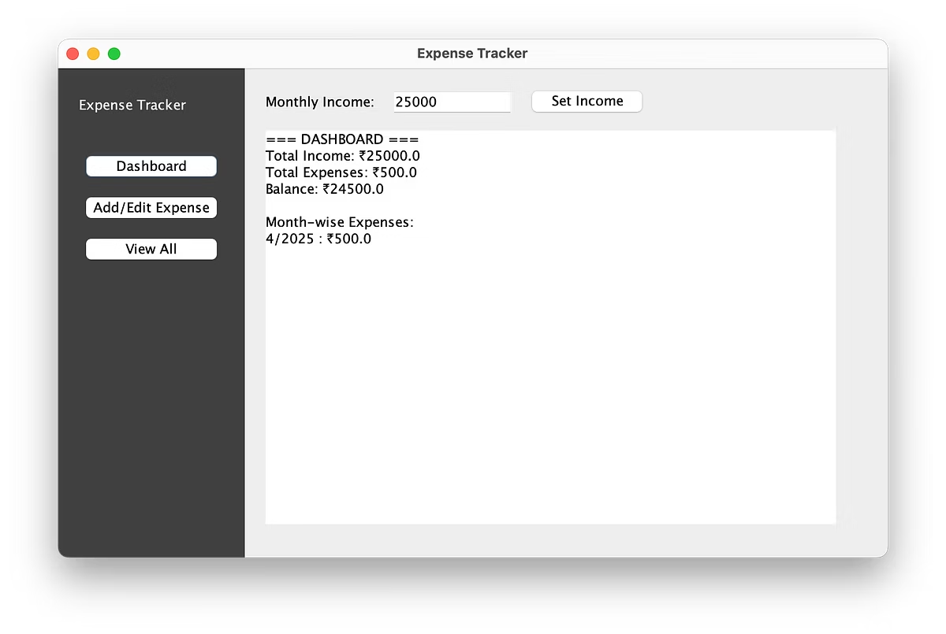


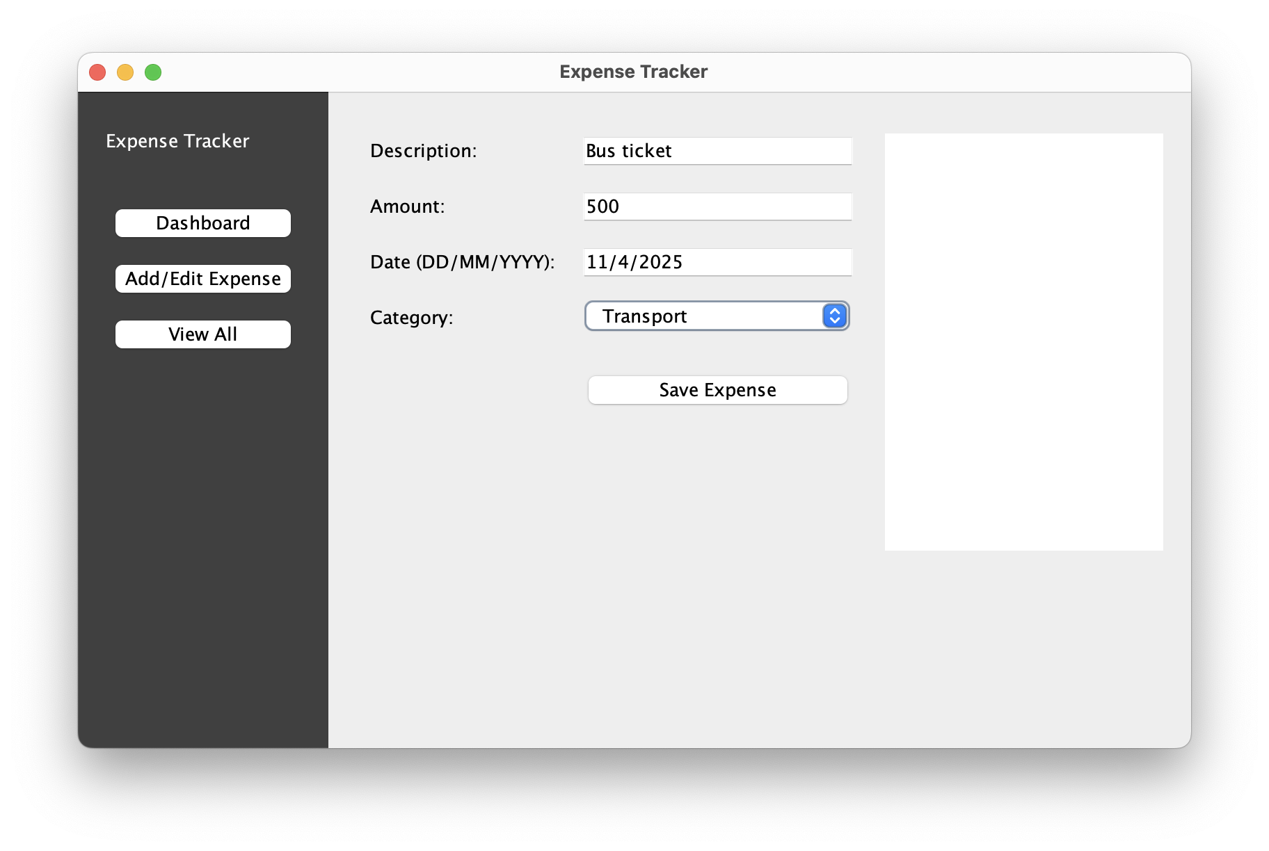

Working of the Expense Tracker System
Dashboard Panel
Users set monthly income and get an overview of balance and expenses summarized for the month.
Add/Edit Expense Panel
Provides fields for entering expense details and capabilities to modify existing entries seamlessly.
View Panel
Displays full transaction history with an option to refresh data to view the latest records immediately.
The system dynamically switches among panels based on sidebar navigation, ensuring fluid user interaction and data management.

Slide 7
Java Swing Concepts Utilized
Swing Components
Event Handling
JFrame, JPanel for window structure
Implemented using ActionListener and ListSelectionListener to respond to user actions dynamically.
JButton, JTextField, JLabel for user inputs and labels
JComboBox, JTextArea, JList for selection and detailed inputs
OOP & Data Management
Layout Management
Encapsulation through the Expense class and dynamic data handling using ArrayList. Additional use of TreeMap and DefaultListModel for organized data structures.
Components positioned manually using setBounds() for custom UI arrangement ensuring precise control over element placement.

